Slide 1
Heart disease detection project
P122 - Group 4

Slide 2
Names of group members:
Ms. Harshada More
Ms. Vaibhavi Taide
Mr. Nagaraja M. R.
Mr. Ganesh N. R.
Mr. Parag Wani
Ms. Mansi Solanki

Slide 3
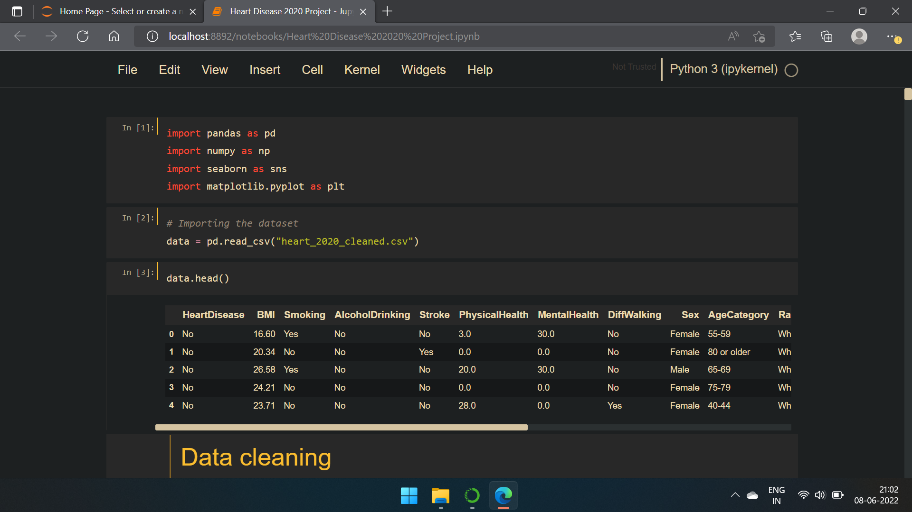
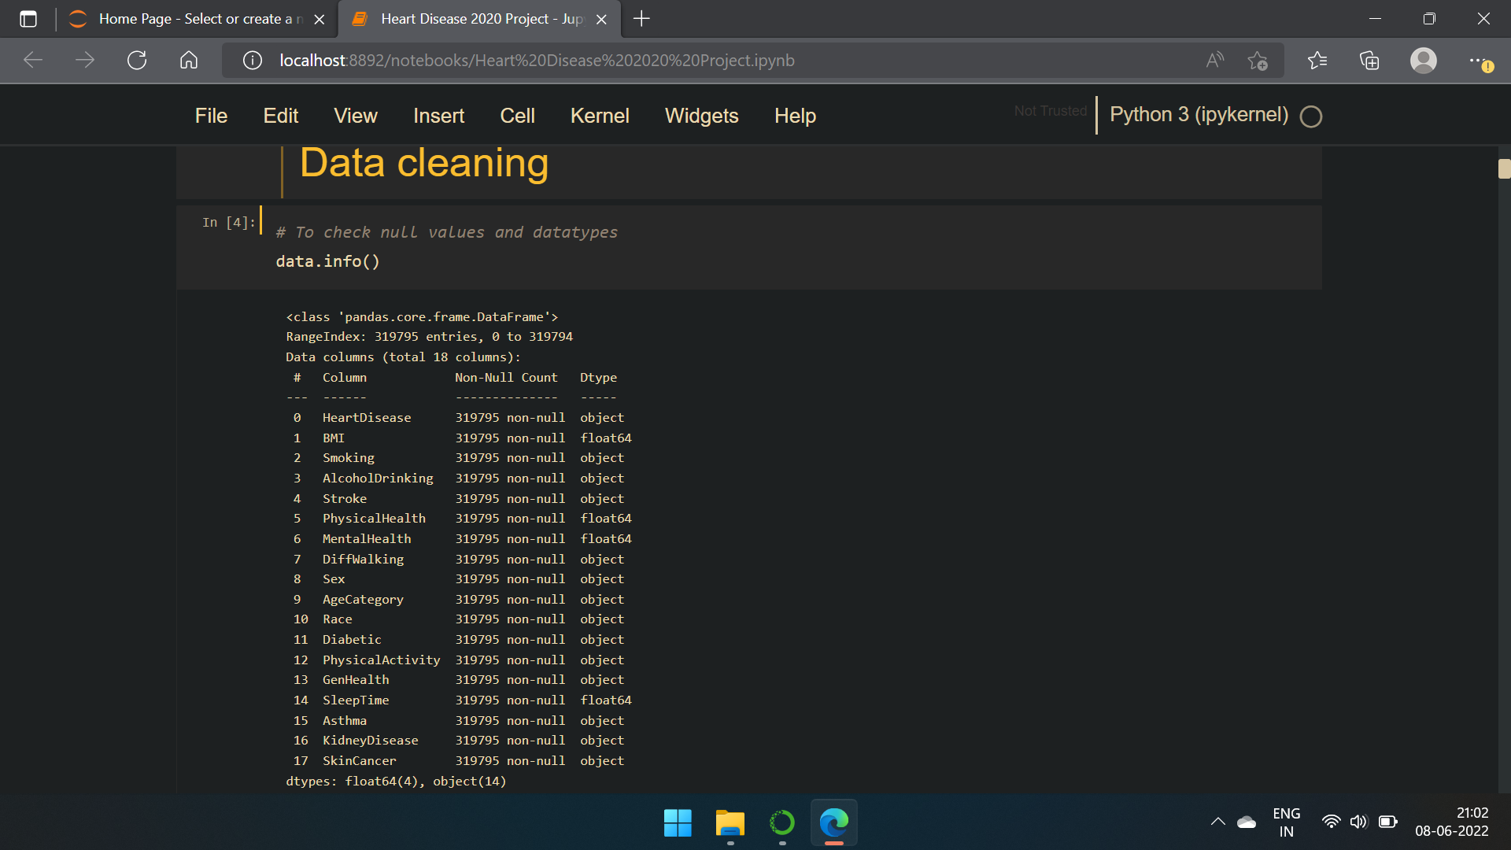
Importing dataset Data cleaning EDA

Slide 4
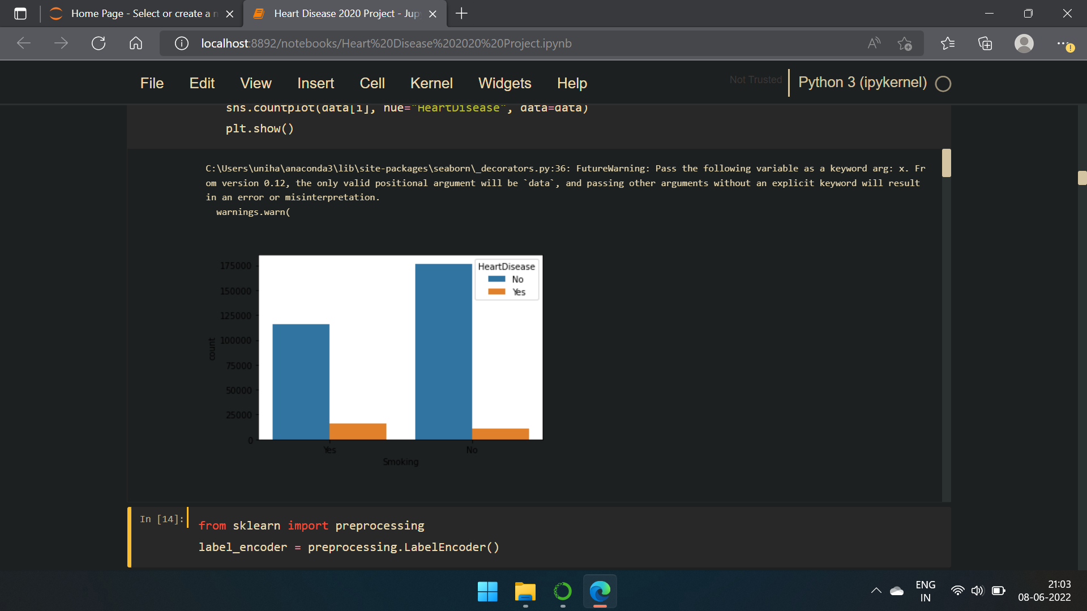
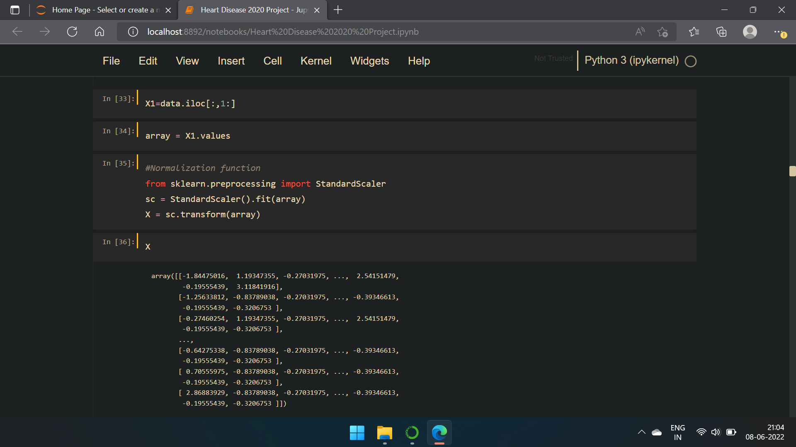
Visualisation Label encoder Defining variables Train-Test split data

Slide 5
Model analysis performed for the following models:
Logistic regression
Decision Tree Classifier
KNN
Naïve Bayes
XGBM
LGBM
SVM
Random forest

Slide 6
Model analysis performed:
Confusion matrix
Model accuracy for training data
Model accuracy for test data
Classification report

Slide 7
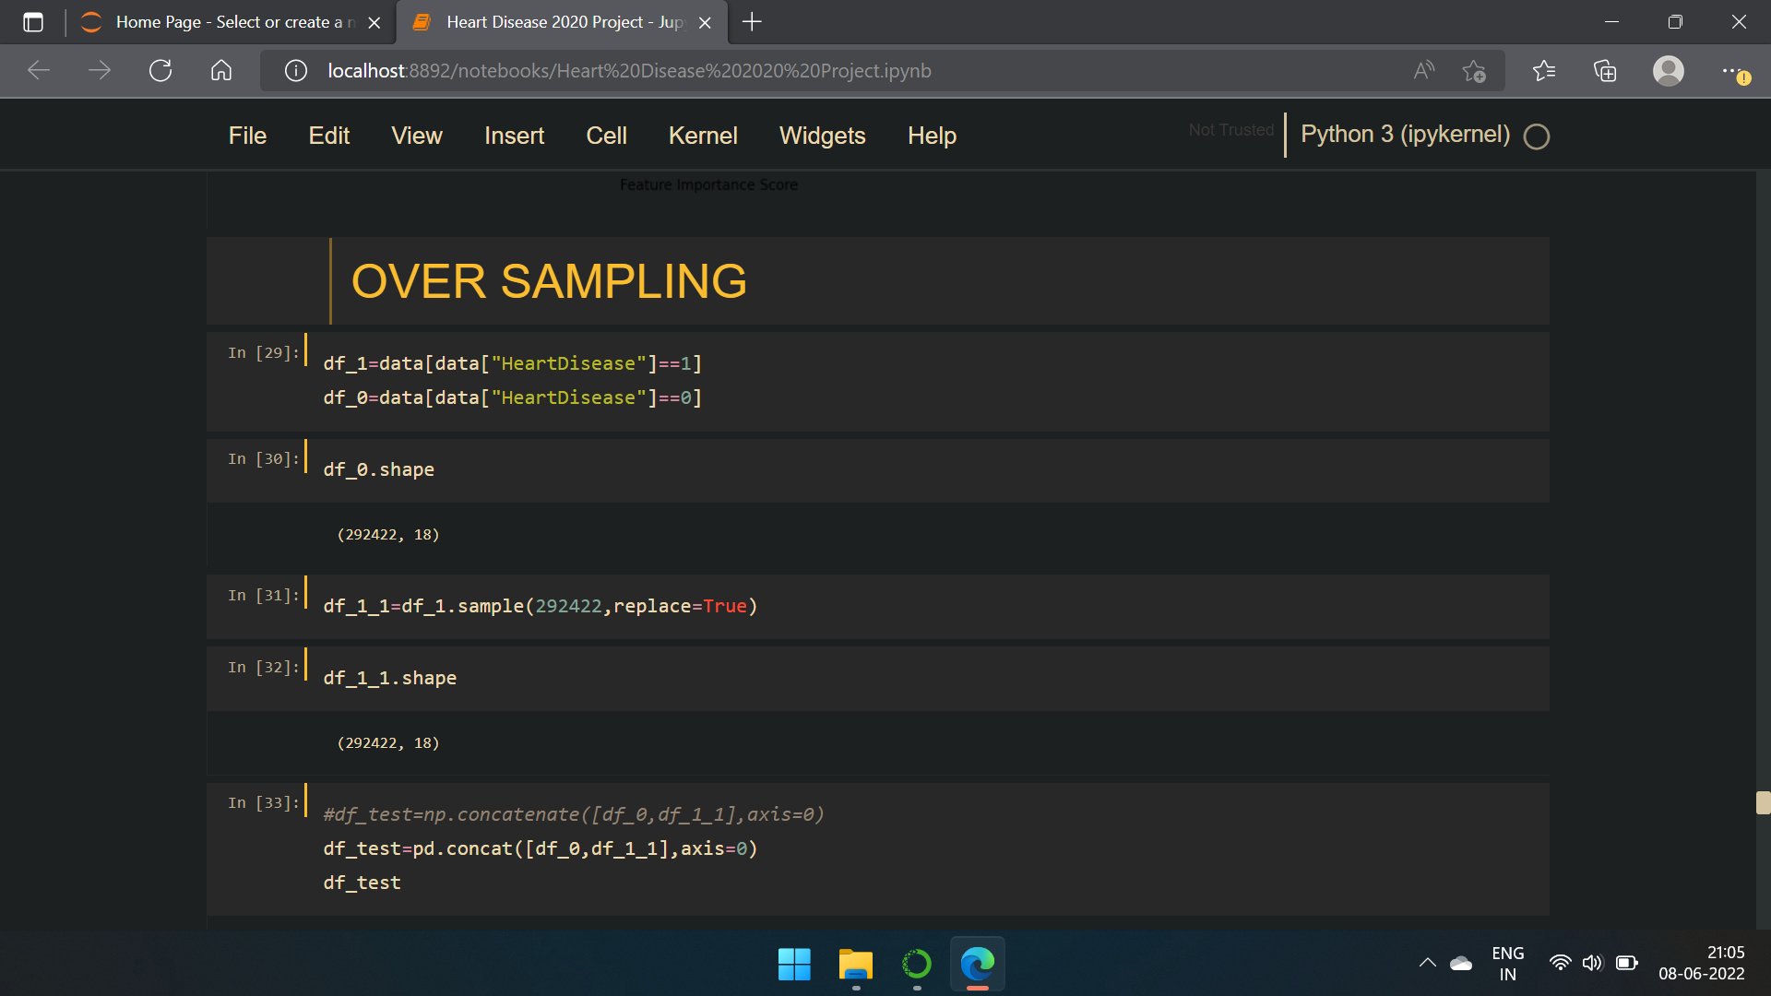
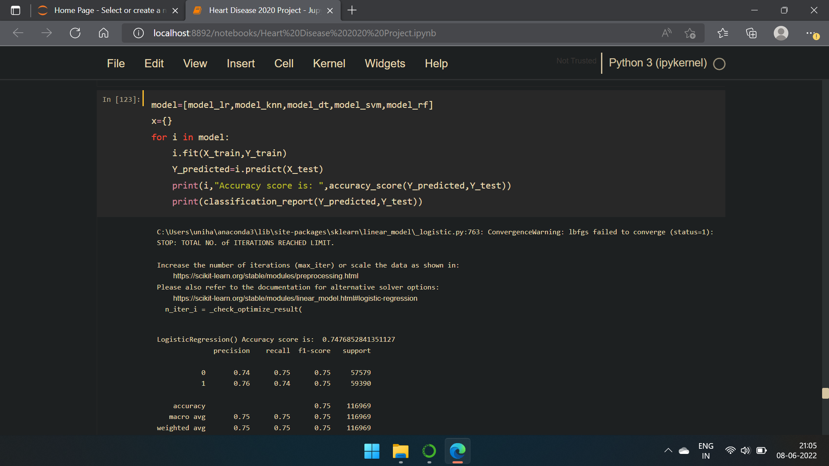
Over sampling model analysis

Slide 8
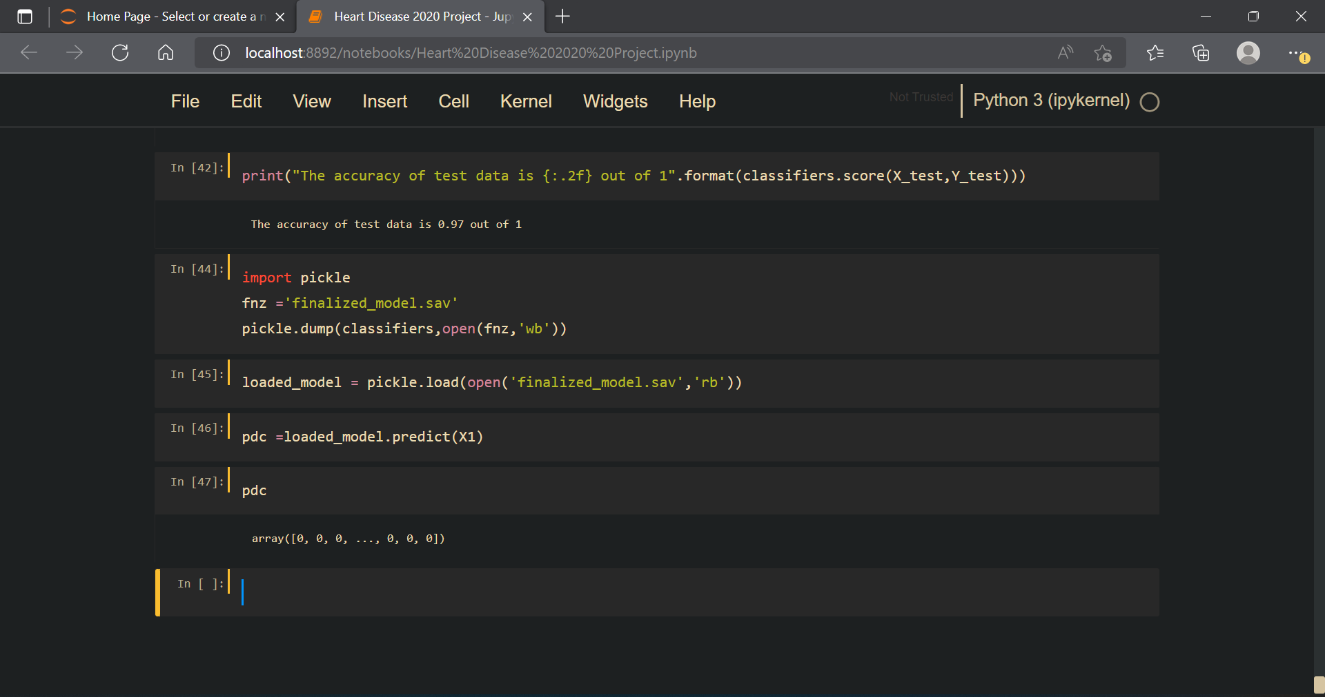
Saving the finalized model – Random forest by using pickle

Slide 9
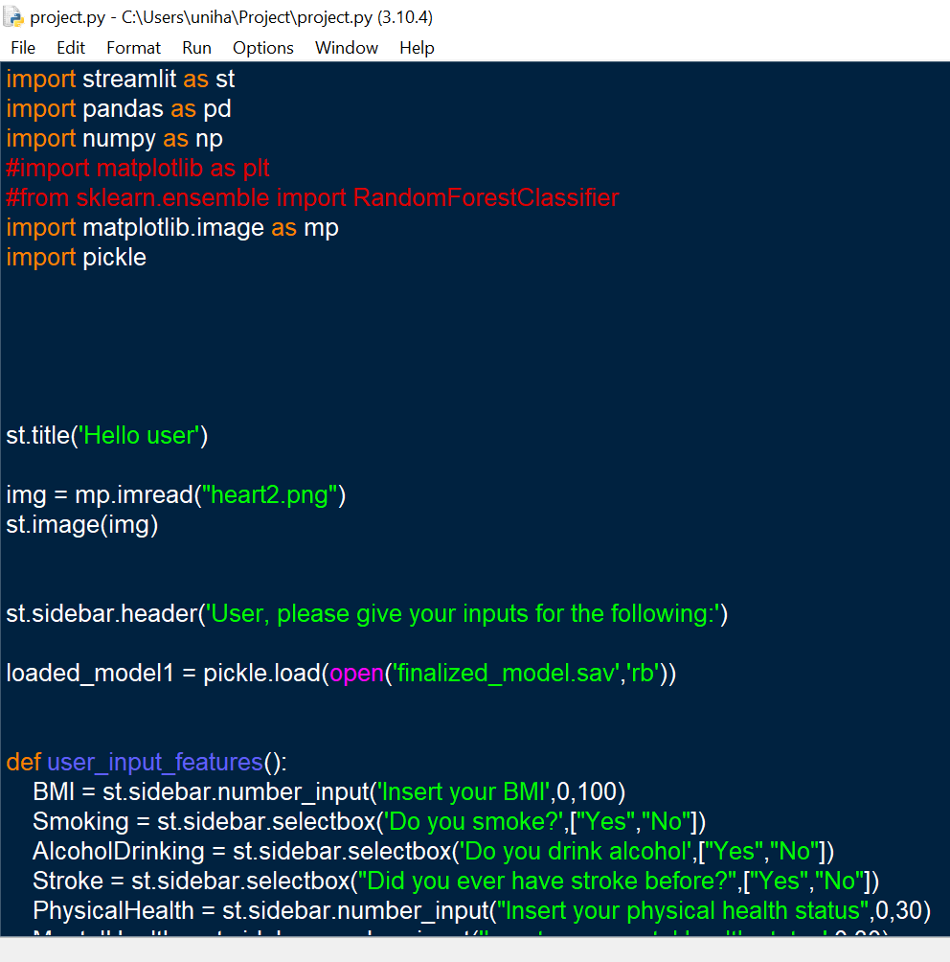
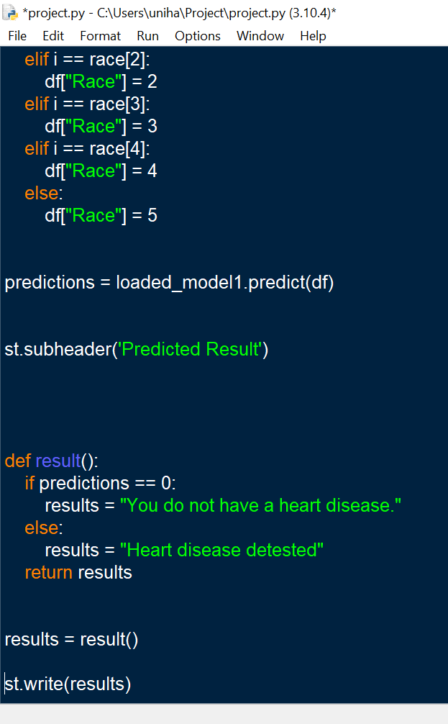
Streamlit code (Part of the code)

Slide 10
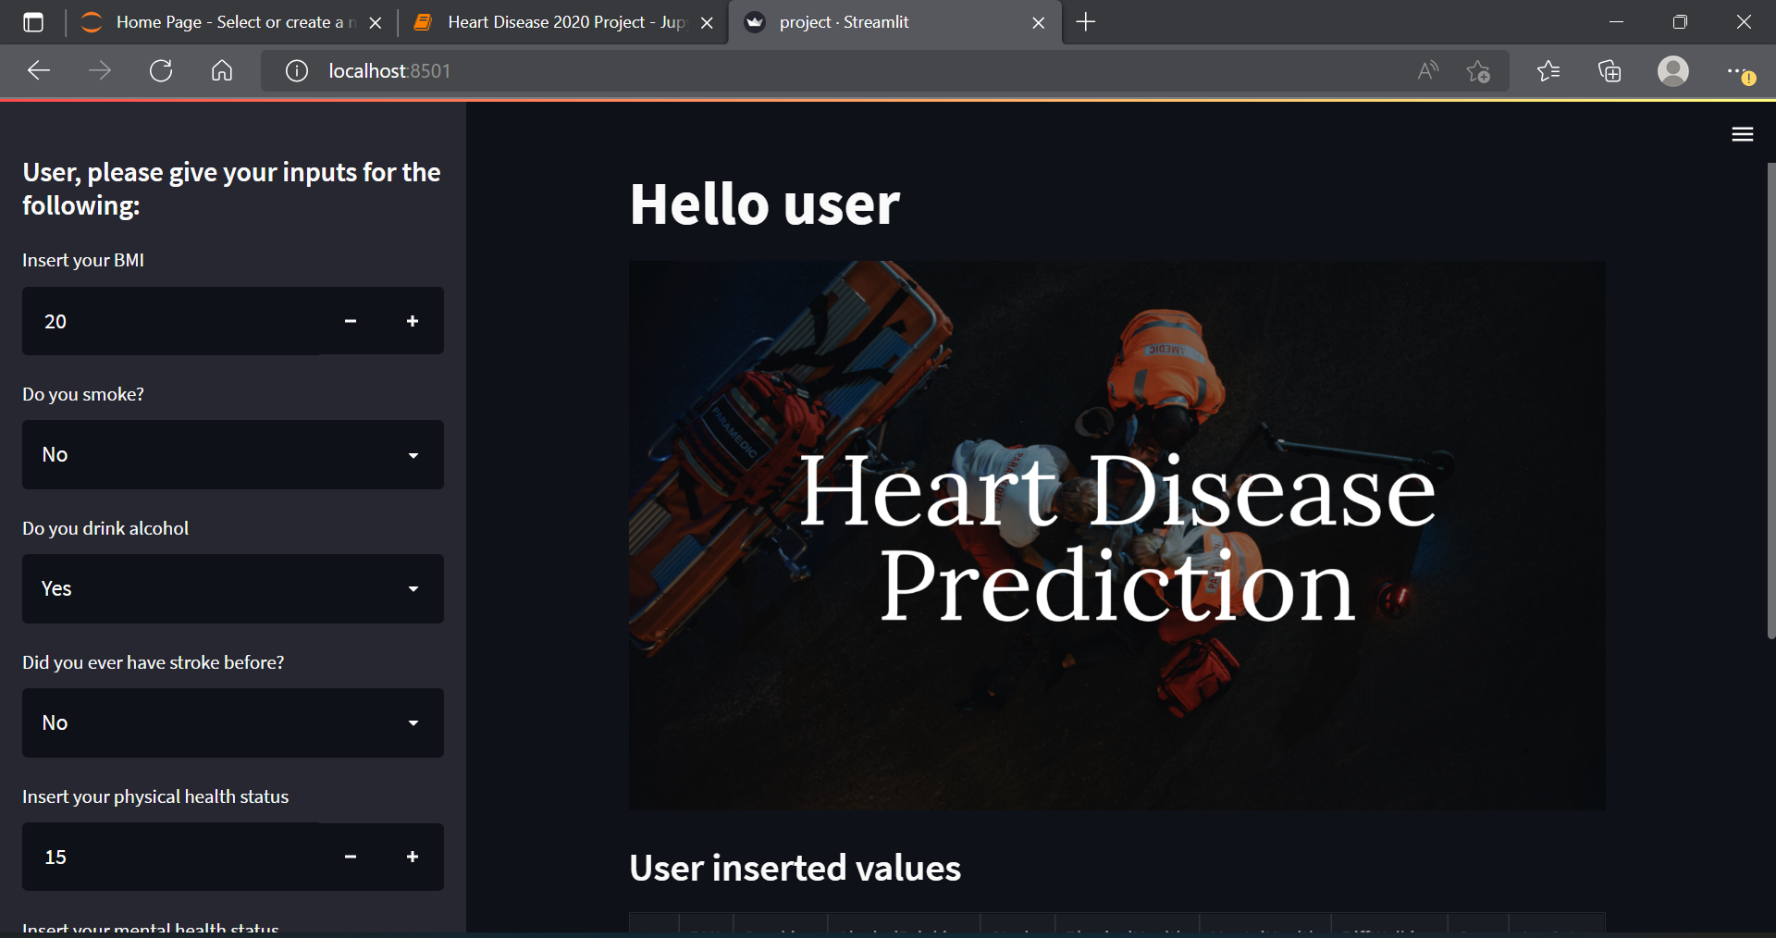
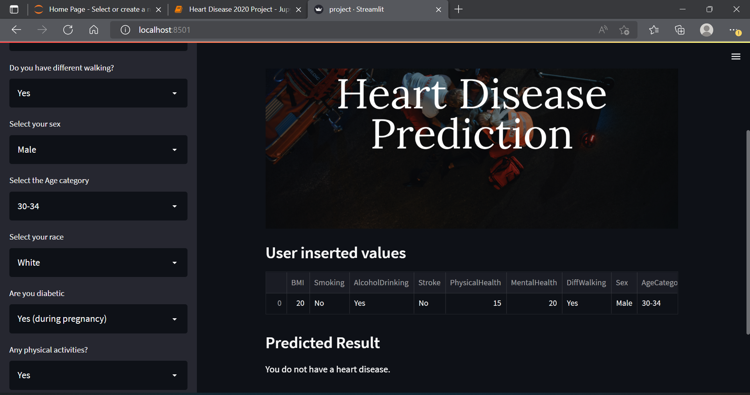
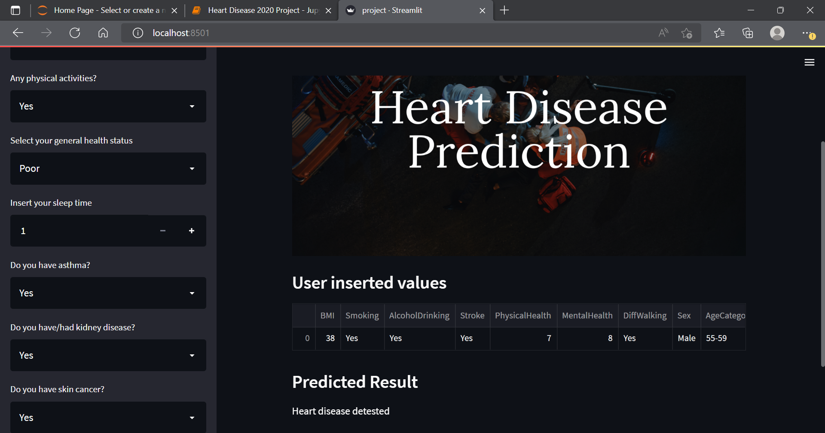
Model final output

Slide 11
Github links:
Harshada More - https://github.com/Harshadamore25/Heart-disease-detection-project

Slide 12
Thank you…

